Slide 1









Sitemap
- Home
- Plant
- Business
- About
- Color
- Font Family :
domaine font

Slide 2

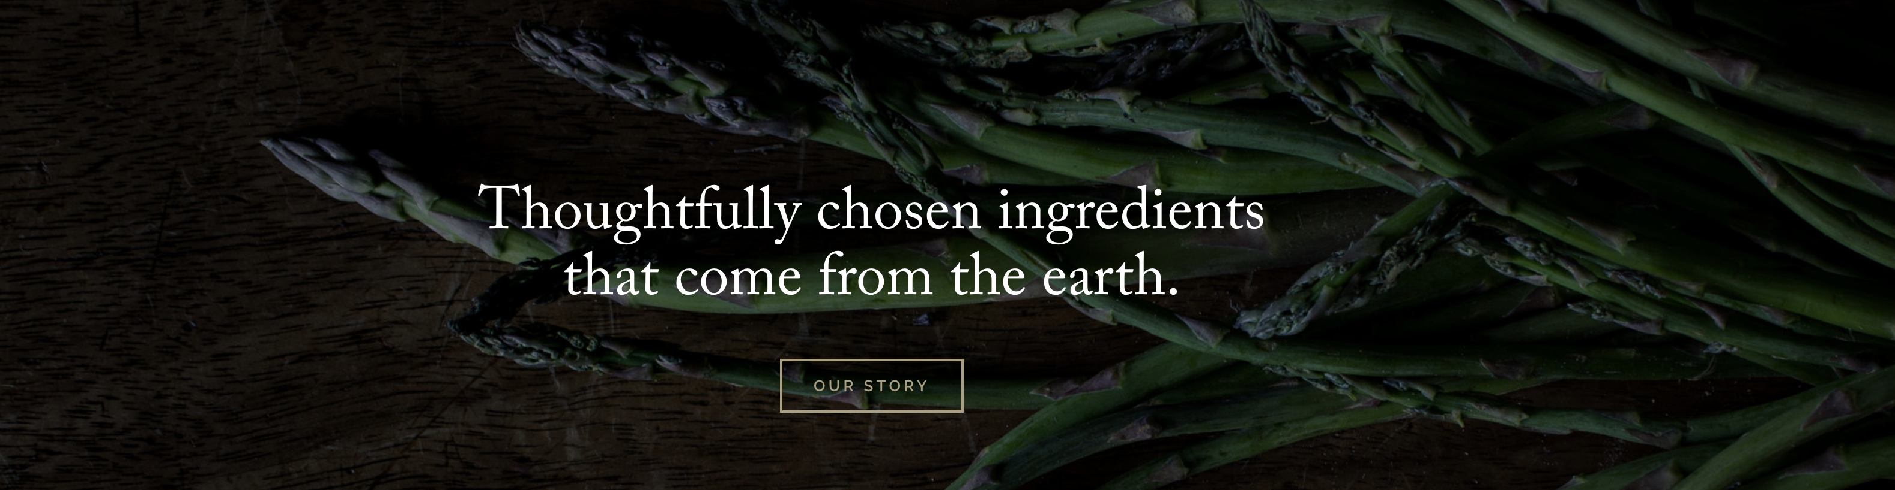

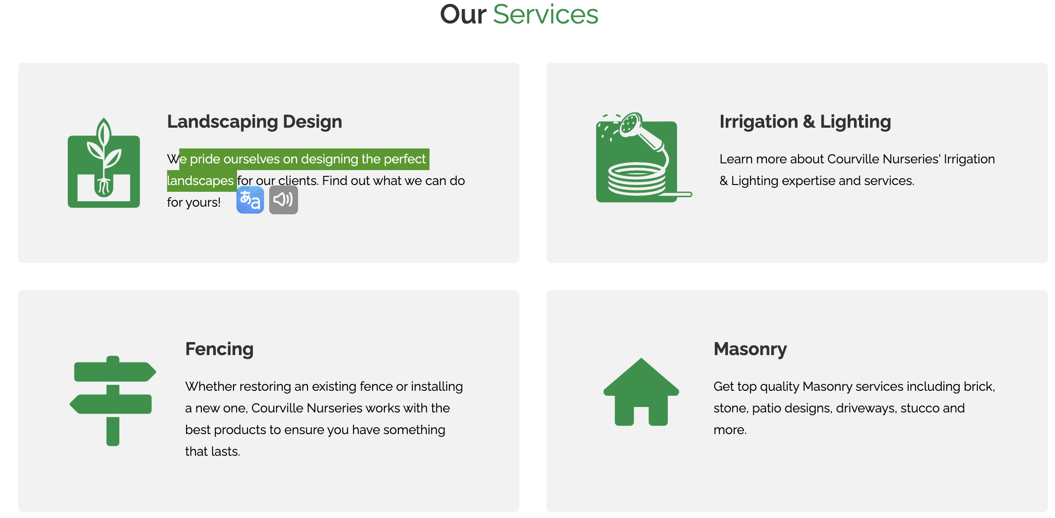
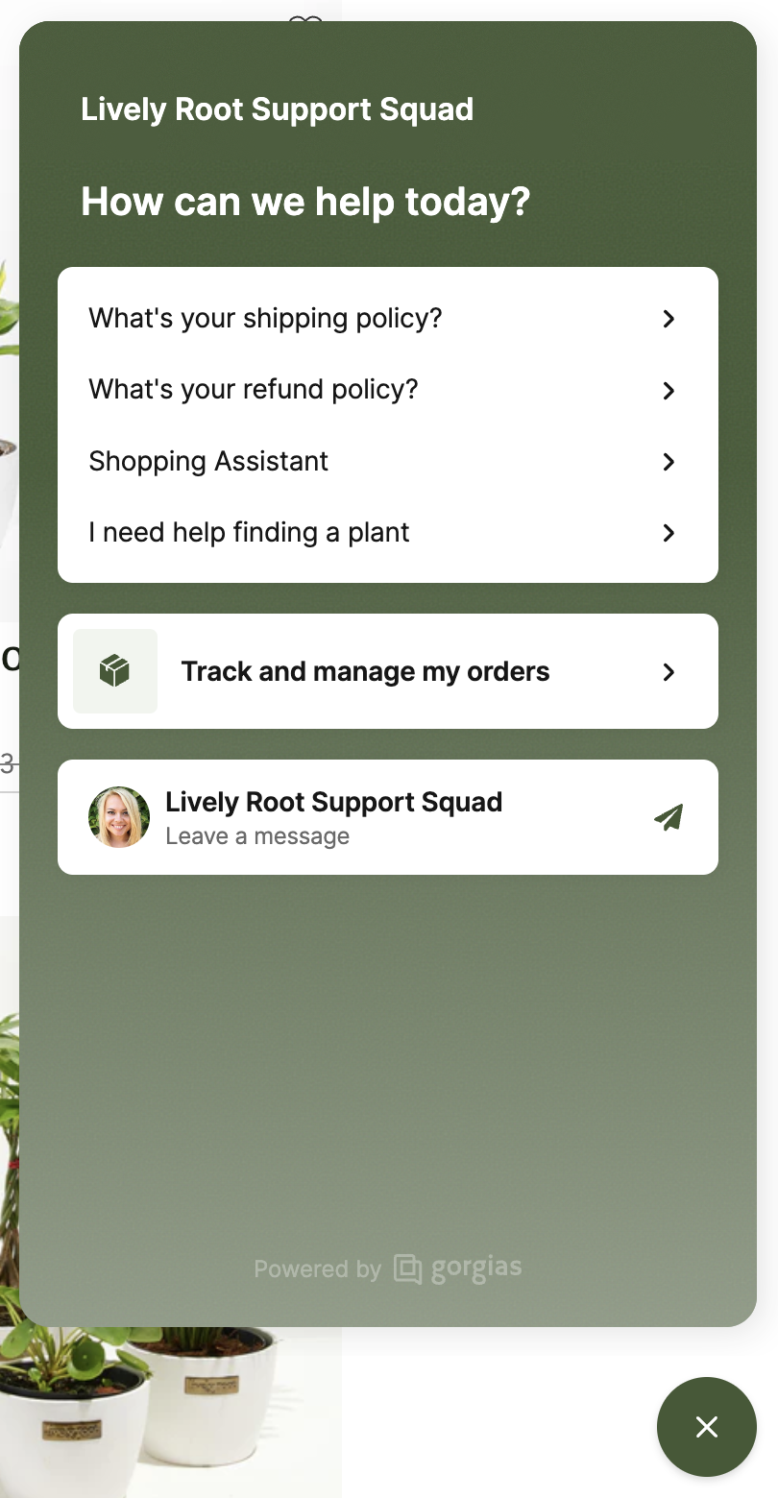
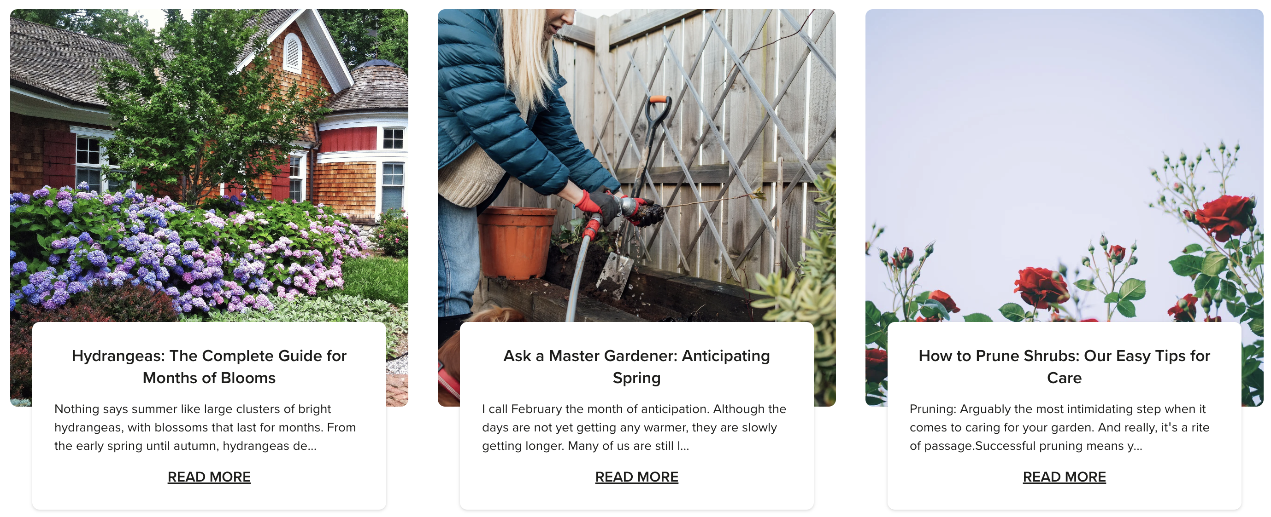

Home
Make your own garden today! Detail information
Home Plant Business About
Get plant care pro tips for seasons

Slide 3

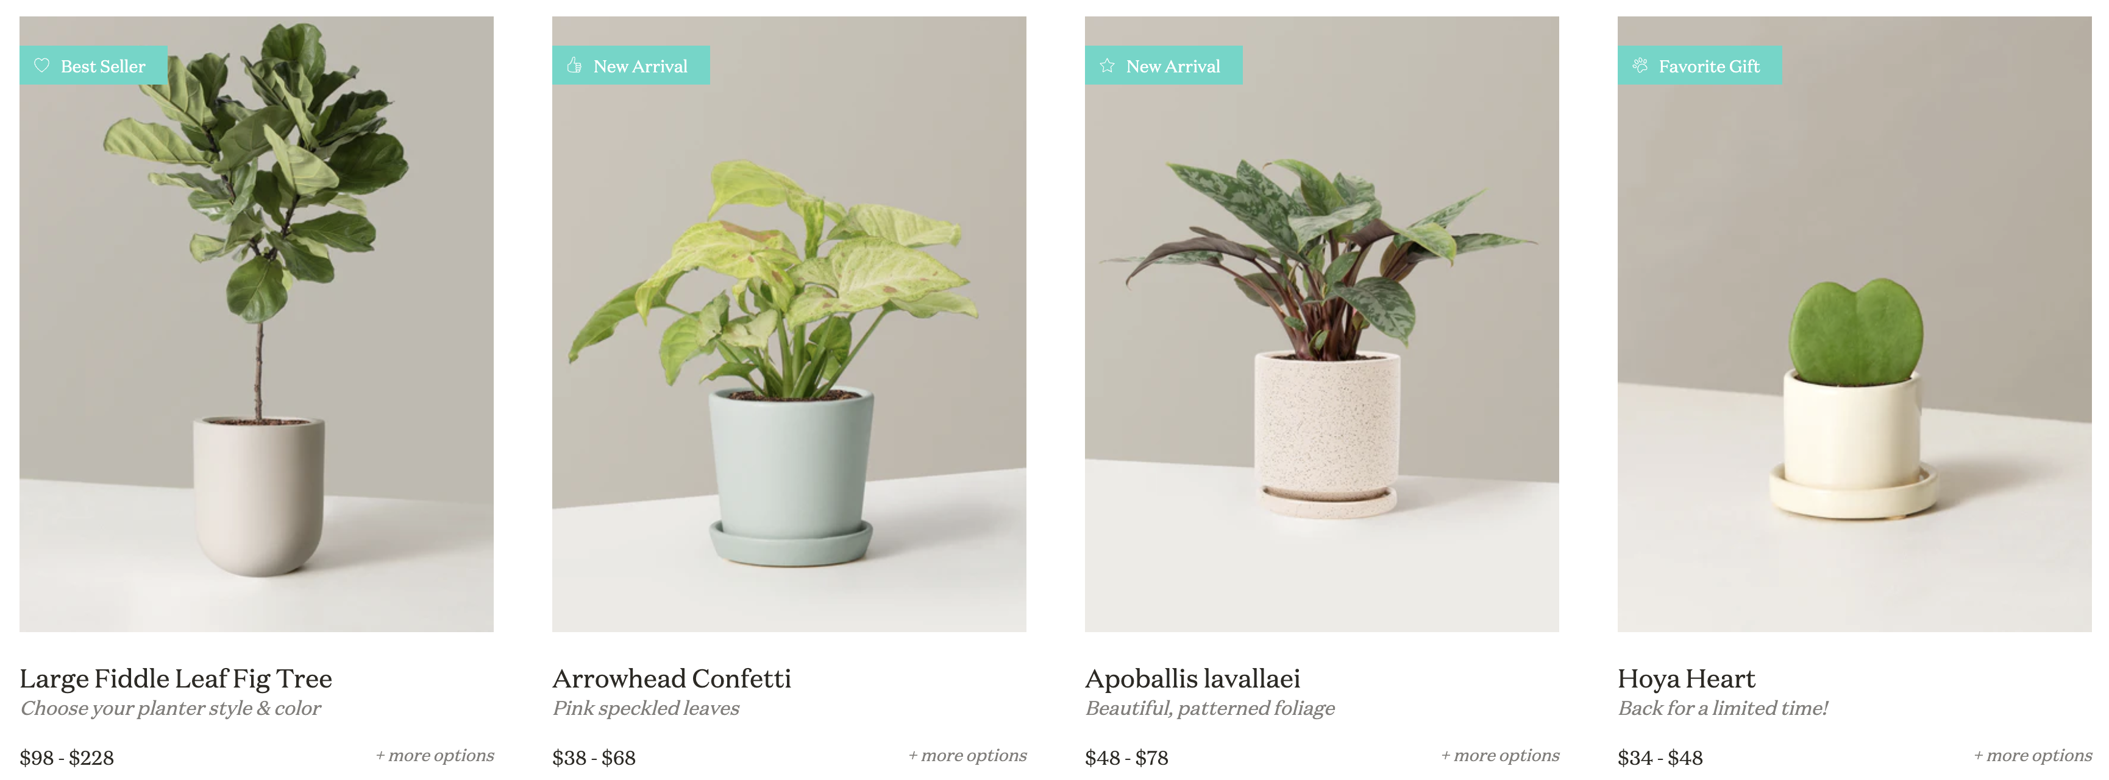
Plant
Make your own garden today! Detail information
Home Plant Business About
Collections | Small | Medium | Large | Huge

Slide 4


Business
Make your own garden today! Detail information
Home Plant Business About
Over 10,000 of
5 Star Reviewed
30 Years of
Industry Experience
Professional
garden architect
PORTFOLIO

Slide 5
Business
Make your own garden today! Detail information
Home Plant Business About
Discover Your Garden Oasis
We combine sustainable designs with innovative landscaping to transform your space into a serene and inviting oasis.
Explore our design portfolio
Green Living Starts Here
Discover vibrant plants for both indoor and outdoor spaces. Our plants enrich your life and breathe new energy into your home.
Shop our plant wholesale business
Meet Our Green Team
Meet Jason, our garden architect, and Maria, our dynamic marketer, as they work together to create stunning spaces.
Learn about our team

Slide 6
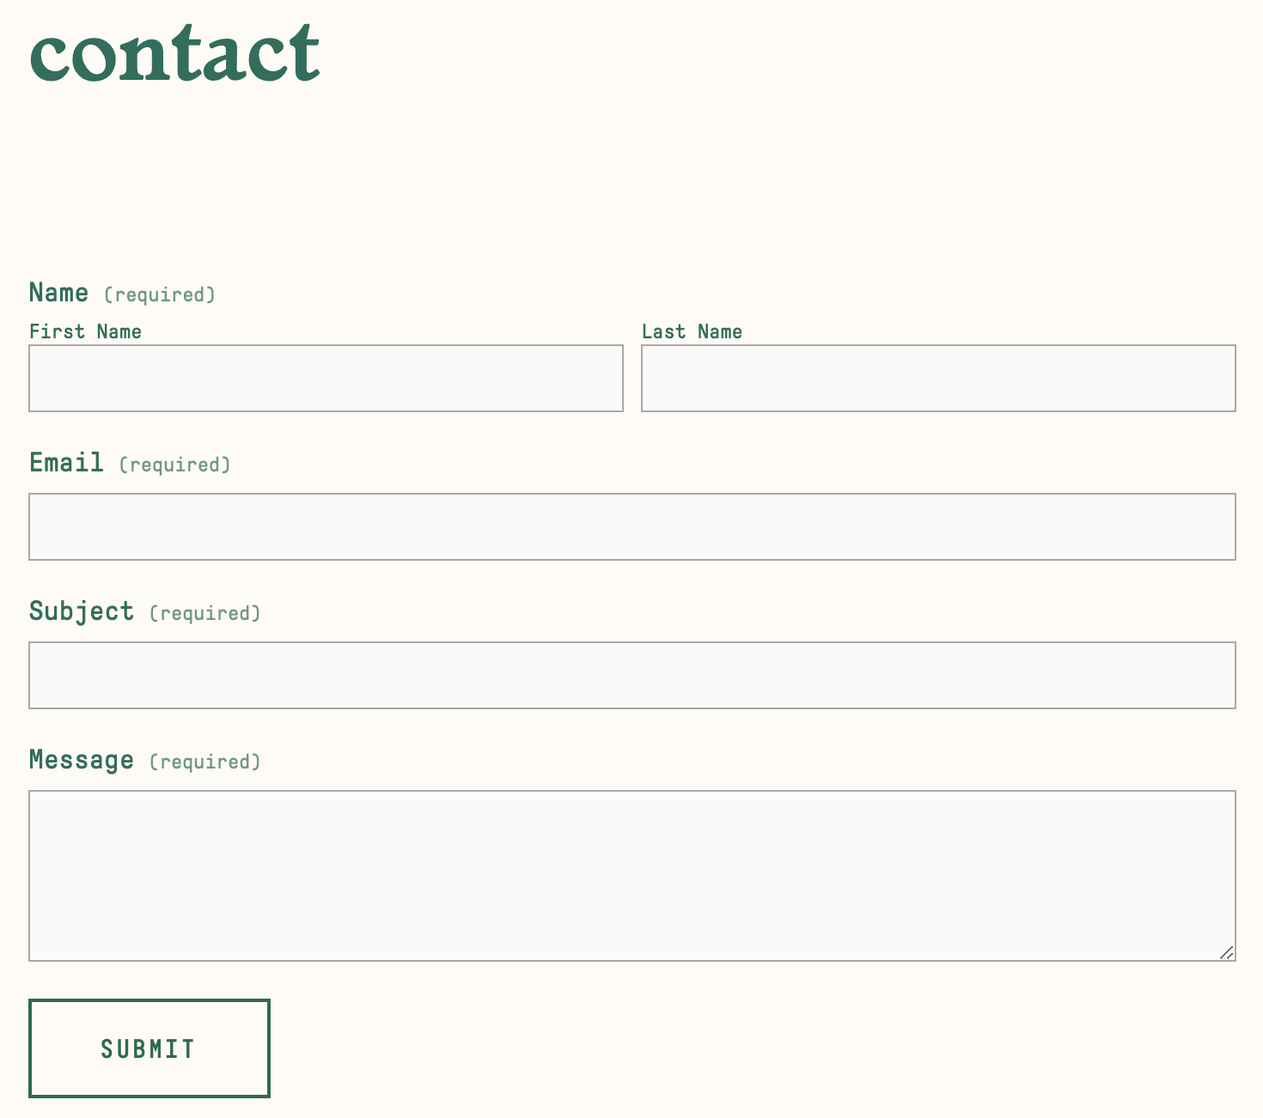
Business
Make your own garden today! Detail information
Home Plant Business About
Fill out this form and one of our experts will get in touch soon

Slide 7
About
Make your own garden today! Detail information
Home Plant Business About
our purpose
1. **Company Overview**
- Lucky Shrub, a garden design and plant wholesale company based in Tucson, Arizona.
- Vision and Mission: Our goal is to create beautiful spaces for our customers and promote sustainable living.
2. **History**
- Founders: Co-founded by husband and wife, Jason and Maria.
- Founding Story: Started by two plant lovers with a passion for creating more beautiful spaces.
3. **Our Values**
- Sustainability: Encouraging sustainable living through eco-friendly designs and plant wholesale.
- Creativity and Innovation: Providing unique experiences to our customers through new design and landscaping ideas.
4. **Our Services**
- Garden Design: Offering modern and sustainable garden design and landscaping services.
- Plant Wholesale: Operating a wholesale business selling a variety of indoor and outdoor plants.
5. **Our Team**
- Jason: Leading as our garden architect, managing designs and the team.
- Maria: Handling marketing and plant wholesale operations, focusing on customer service.
6. **Our Achievements**
- Customer Success Stories: Showcasing spaces we've designed and customer satisfaction stories.
- Awards: Highlighting awards in design and environmental recognition.

Slide 8

Contact Us
Have questions or want to order over the phone?
We're here to help. Talk to our Plant Experts.
(516) 717-9138
Feel free to Contact Us
Stay Rooted with Lucky Shrub
Join the Lucky Shrub family for special offers, new products, expert advice and more.
Email
Subscribe
Copyright© 2024 LuckyShrub. Co., Ltd

Slide 9
References
https://www.fast-growing-trees.com/pages/resource-center (icons 35x35)

